Slide 1
PORT OF LIVERPOOL CONTAINER TERMINAL
The Customer Access Portal (CAP)
Requesting Access
Using the CAP to make appointments
Training Document

Slide 2
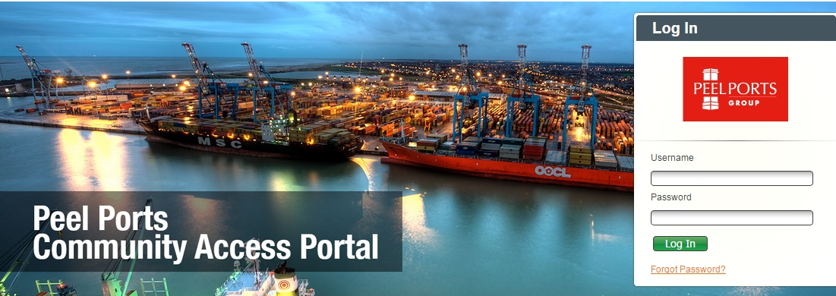
Welcome to the Port of Liverpool
This document will explain the process of arranging for the delivery or collection of a container, arrival and departure from the port through our Community Access Portal (CAP).
Before arriving at the Port of Liverpool you should have a valid appointment already in our system for your vehicle.
In order to do this you must have a log-in for your organisation.

Slide 3
CAP - Requesting Access
In order to register for access to the CAP we require the following information:
Company Name
Company Address
Contact Email Address
Contact Telephone Number
Contact Mobile Phone Number
Contact Name / Names
How many times per week do you visit the port
Your request will be processed and you will receive a return email within 2 working days providing:
Your username
Your password
A link to the CAP login screen
A copy of the terms and conditions of use
Your password must be changed when you first log in to the website.
Do not share this information with anyone.

Slide 4
Appointment Slots
We will use the information given to us to calculate the number of appointment slots required by your company.
This will be reviewed every quarter to assist with the smooth operation of the AutoGate.
The utilisation of appointments will be monitored. Failure to use appointments may result in sanctions.
If you have any need to discuss with us your appointment requirements, forward your queries to:
Customer.services@peelports.com
In each communication please provide to us your CAP username, and the name of the Haulage company you represent.

Slide 5
The Customer Access Portal

Slide 6
CAP - How to Log In
Community Access Portal – How Do I Log In?
Enter Username that you have been provided with
Enter Password that you have been provided with
Once the above have been entered, click on ‘Log In’
If you have forgot you password then click ‘Forgot Password’ and follows the instructions to re-set

Slide 7
Haulier CAP - Home Screen Navigation
When you first log in you will be presented with two options in the top left:
File:
User Preferences
Gate:
Announcements
Appointments
Truck Visit Appointments
What Is The Difference Between A Truck Visit Appointment and An Appointment?
Truck Visit Appointment: This is used to book the visit of a truck to the terminal, this will be to either collect or deliver a container(s).
Appointment: This is used to book a job (Import/Export/Through/Dray/Empty). Once completed you will associate this appointment against the previously created truck visit appointment

Slide 8
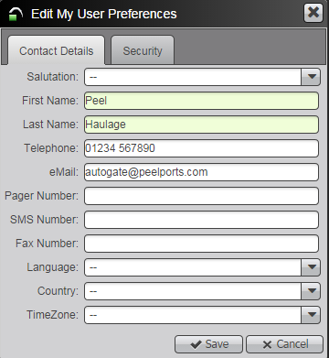
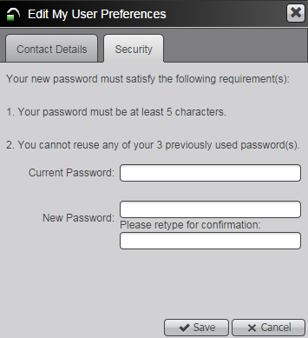
Haulier CAP - User Preferences
User Preferences:
To open this screen, click on File then User Preferences. :
Here you can enter details on your haulage company as shown above
By clicking on the security tab you can change your log in password
THIS MUST BE DONE UPON FIRST LOGIN
Press the save button to save any changes
INFORMATION MUST BE ENTERED FOR ANY FIELD HIGHLIGHTED GREEN

Slide 9
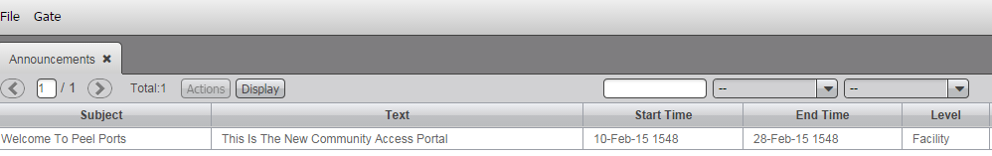
Haulier CAP - Announcements
Announcements:
To keep up to date with latest Port announcements and information, regularly check the announcements window.
To open this window, click on Gate then Announcements

Slide 10
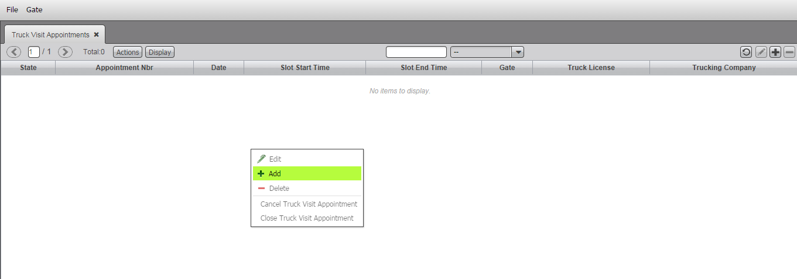
Haulier CAP - Truck Visit Appointments
Truck Visit Appointments can be accessed via clicking on Gate then Truck Visit Appointments. From this screen we can create an appointment for a vehicle to visit the terminal to collect/deliver a container
To start creating an appointment
Right click and select ‘add’
Or
select the ‘+’ icon in the top right.

Slide 11
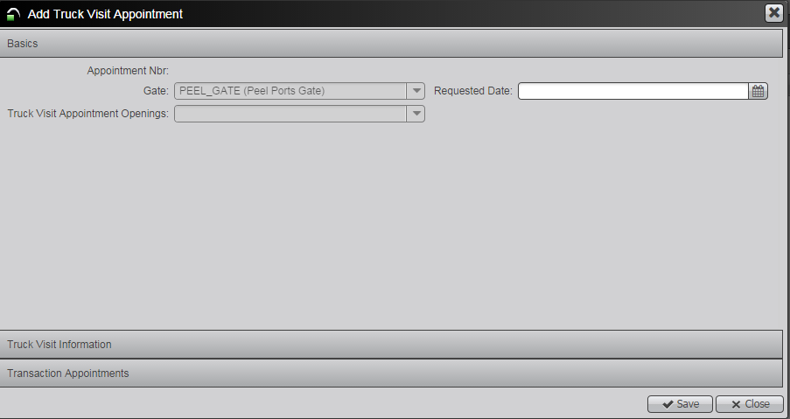
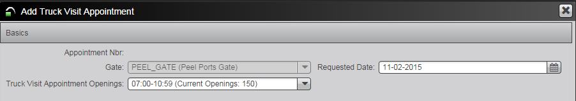
Add Truck Visit Appointment
The Truck Visit Appointment form enables you to add/edit truck visit appointments
Requested Date:
From calendar select the date that your vehicle is due to visit site
Truck Visit Appointment Openings:
Select the relevant truck visit appointment slot (there are certain amount of slots available during each window – the above circled shows between 07:00-10:59 there are 150 slot openings available)

Slide 12
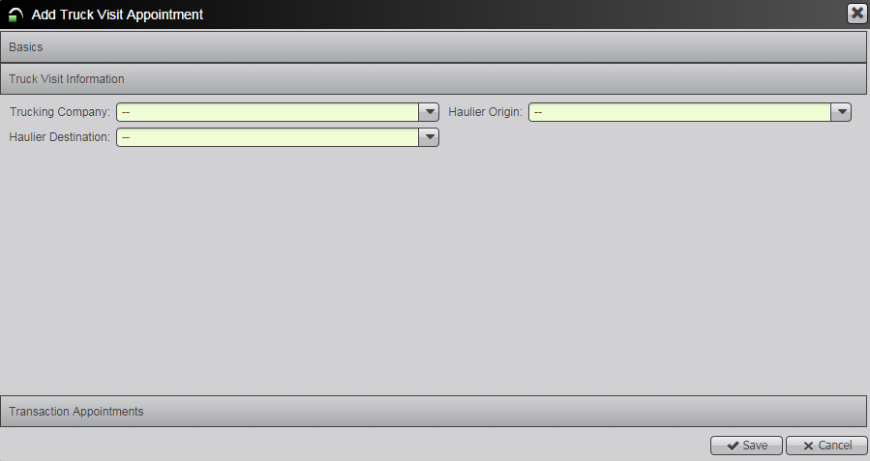
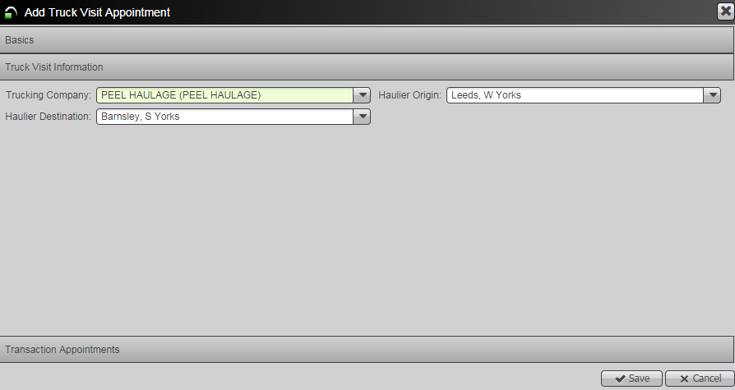
Add Truck Visit Appointment
Truck Visit Information:
By clicking on the grey “Truck Visit Information” bar you can now expand this section to continue putting in appointment details:
Trucking Company:
Select your company from the drop down.
Haulier Origin:
Select the container origin (Town / City) from the drop down.
Haulier Destination:
Select the container destination (Town/City) from the drop down.

Slide 13
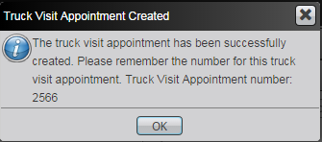
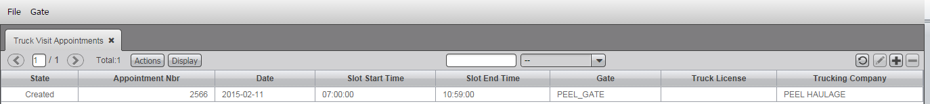
Add Truck Visit Appointment
When you are happy with your TVA details, click “Save” in the bottom right corner.
It is important that you note the TVA appointment number down. This number your driver will be using when they reach the port, and you will soon be associating containers with it.
When you are happy, click OK to close down this pop-up.
The Truck Visit Appointment will now be displayed on the Truck Visit Appointments screen.
You will notice that in the State column it will read ‘Created’. This means that there is an active appointment that has yet to be used

Slide 14
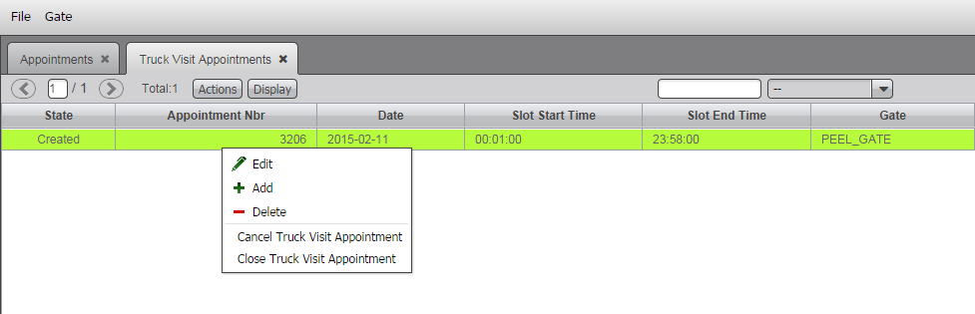
Edit Truck Visit Appointment
The edit function allows you to amend any information in the Truck Visit Appointment that you have previously created. Once edited just press Save, the Truck Visit Appointment Number will remain the same.
Locate Truck Visit Appointment that needs editing on the Truck Visit Appointment screen. Click on it so that it highlights green, right click and select Edit or click on the ‘pencil’ icon on the right hand side of the screen.
The Edit Truck Visit Appointment box will now open and you can make relevant changes.

Slide 15
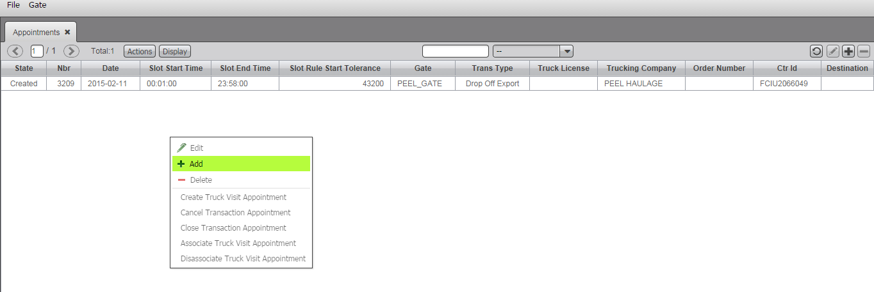
Haulier CAP Gate > Appointments
The Appointments section allows you to book a container appointment to come in/out of the terminal. You can then associate this appointment with the truck visit appointment that you have previously created.
To create an appointment right click on the appointments screen and select ‘+ add’ or select the ‘+’ icon, both highlighted in red above

Slide 16
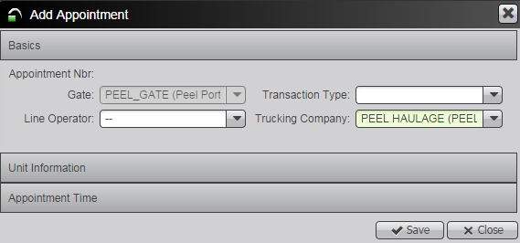
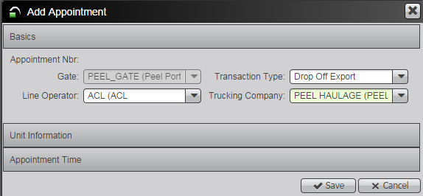
Add Appointment
BEFORE
AFTER
Line Operator
From the drop down arrow select the line operator for the container that you are collecting/delivering
Transaction Type
Select what type of appointment you are creating

Slide 17
Transaction Types
Dependant on what Transaction Type you have selected, to complete the Unit Information section you will firstly need to have the below information:
DROP OFF EXPORT PICK UP IMPORT
Container Number Container Number
DROP OFF EMPTY PICK UP EMPTY
Container Number Container Number
Booking/Order Number Booking/Order Number
THROUGH CONTAINER (Remain on Vehicle)
Container Number
Position On Truck
ONCE YOU HAVE THE ABOVE INFORMATION YOU CAN PROGRESS WITH ADDING THE APPOINTMENT
In the CAP frustrated containers (Import or Export) are referred to as DRAY transactions.
To book an Import Dray In, or an Export Dray Off you need to know the container number.

Slide 18
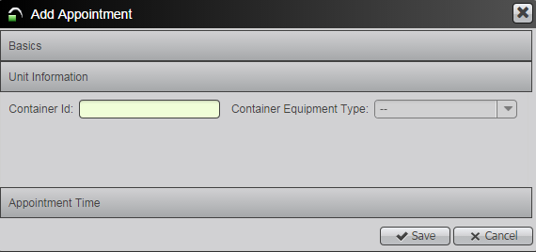
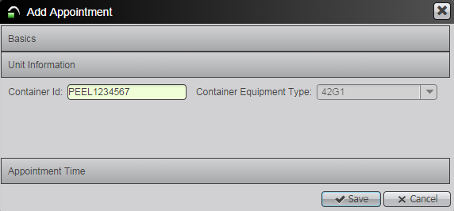
Unit Information
BEFORE
AFTER
By clicking on the grey bar that says “Unit Information” you can now associate more information with your appointment.
Enter Container Id
Tab out and the Container Equipment Type will be displayed

Slide 19
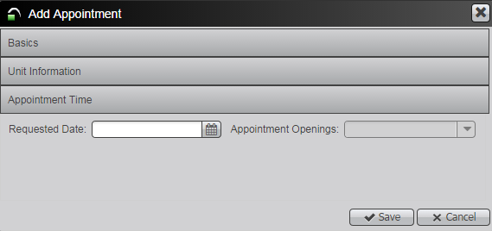
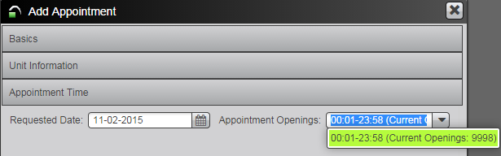
Haulier CAP Gate > Appointment Time
BEFORE
AFTER
Requested Date
Only calendar icon, select the date that you are looking to visit the terminal (this should match the date that you selected for your truck visit appointment).
Appointment Openings
From dropdown arrow select the appointment opening slot for the time that you will be visiting the terminal. You will notice in brackets by the appointment window is the remaining amount of transaction slots available to book during that time period.

Slide 20
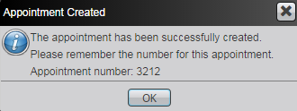
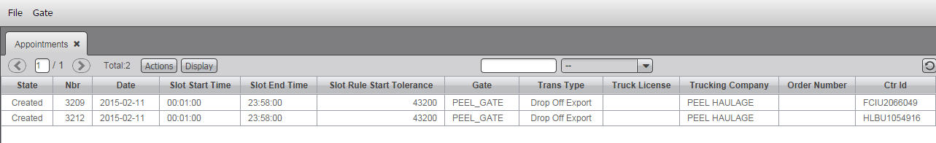
Haulier CAP Gate > Appointments
When you are happy with your TVA details, click “Save” in the bottom right corner.
It is important that you note the Appointment number down as you will need to associate it with the Truck Visit Appointment
We can now see the appointment that you have created displayed in the appointments screen.
In the ‘State’ column you will notice it reads ‘Created’ this means that the appointment is active and not yet been used

Slide 21
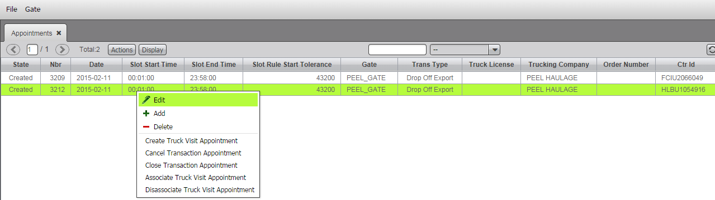
Edit Appointment
The edit function allows you to amend any information in the Appointment that you have previously created. Once edited just press Save, the Appointment Number will remain the same.
Locate the Appointment that needs editing on the Appointments screen. Click on it so that it highlights green, right click and select Edit or click on the ‘pencil’ icon on the right hand side of the screen.
The Edit Appointments box will now open and you can make relevant changes.

Slide 22
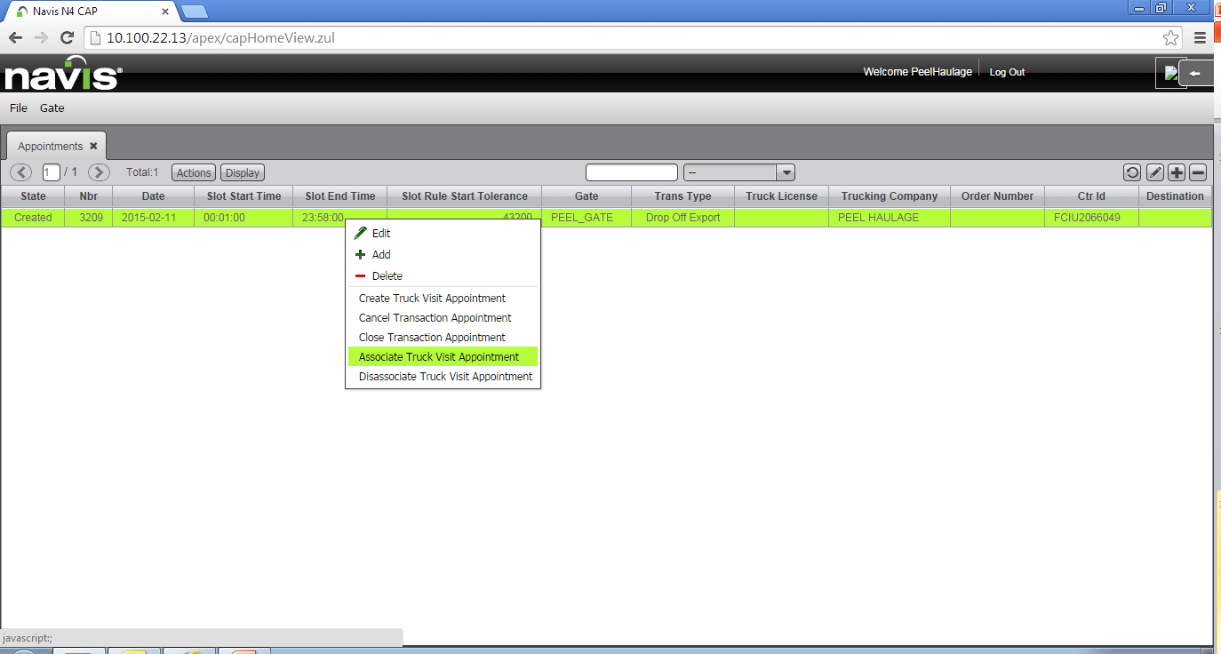
Associate Truck Visit Appointments
Appointments
Right Click On Appointment That You Need To Associate
Select
Associate Truck Visit Appointment

Slide 23
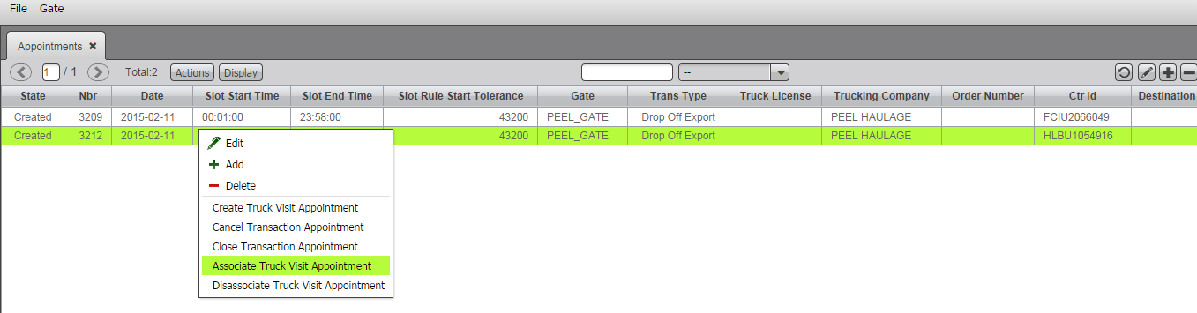

Associate Truck Visit Appointments
You now need to associate the Truck Visit Appointment to the Appointment you have just created
Right click against the appointment and select Associate Truck Visit Appointment
From the dropdown arrow, select the Truck Visit Appointment you previously created and press Save
Your container appointment is now associated to the Truck Visit Appointment and you can visit the terminal on the date and within the timeslot you selected

Slide 24
Associate Multiple Truck Visit Appointments
YOU CAN ASSOCIATE A MAXIMUM OF 4 APPOINTMENTS TO 1 TRUCK VISIT APPOINTMENT.
THIS IS BASED ON MAXIMUM OF 2 X 20’ IMPORT CONTAINERS AND 2 X 20’ EXPORT CONTAINERS.

Slide 25
Haulier CAP – Before Visiting The Terminal
Ensure You Have:
Truck Visit Appointment Number
Bolt Seal Number(s)
PIN (if applicable)
If You Have Paperwork For The Shipping Line Then Drop It Off At Customer Services

Slide 26
Frequently Asked Questions

Slide 27
Frequently Asked Questions
Below we have compiled a list of frequently asked questions and supplied answers to them, if however this does not answer your question please contact the Customer Services.
What is the Community Access Portal (CAP)?
The CAP is a vehicle booking system (VBS) that allows a party responsible for a specific container or group of containers, to log in and arrange appointments to collect and deliver units.
What is the AutoGate?
The AutoGate is a combination of OCR, TRUC, pedestals, and gate software integrated to our Terminal Operating Software that reduces the need for manual intervention at each stage between the delivery and collection of containers.
What is the TRUC?
The TRUC is the Port of Liverpool Haulier ID. It is a photographic ID that ensures that we meet our ISPS regulatory requirements. Each driver must have a TRUC in order to use the AutoGate.
How do I get further help or assistance?
EMAIL: customer.services@peelports.com

Slide 28
FAQ - CAP
The CAP minimum requirements are Microsoft Internet Explorer 10, Chrome 32.0, or Mozilla Firefox 26.0 or later.
Please update your browser software to the latest version in order to ensure maximum compatibility.
I am unable to log in to the CAP?
If you are unable to use the “Forgot Your Password” on the log-in screen, contact our Customer Services where we can investigate.
Can I update my email address?
Yes, the CAP allows you to change your personal information via the File > Preferences menu. Please ensure that you keep these details up to date.
An employee has left my company who used the CAP, what should I do?
To ensure that they no longer have access in your name you should change the password using the File > Preferences menu.
Can I access the CAP using a mobile device?
We are working on delivering functionality to mobile devices in the future.

Slide 29
FAQ - CAP
Do I need an appointment for all units I wish to deliver/pick up?
Yes all units must have a valid appointment attached to them.
Do I need to attach a truck visit appointment to my appointments?
Yes all appointments must have a valid truck visit appointment attached to them.
Up to 4 appointments may be associated with a single truck visit appointment based on 2 containers in, 2 containers out of the terminal.
How long will an appointment be valid?
When you create an appointment you select the window that best suits the time frame you require. The appointment is valid only for the period selected.
How far ahead will I be able to book?
You are only able to select an appointment up to 7 days prior.
Can we change or cancel a booking?
Yes, this can be done via the CAP. Changes must be made at least 1 hour prior to the appointment window opening.
What is an “Appointment Window”?
An appointment will last for a set period of time during the day, this duration of time is considered a “window” during which we will accept that driver and vehicle.

Slide 30
FAQ - CAP
What happens if a driver arrives at the Terminal without an appointment?
The driver will be refused service when they arrive at the AutoGate. You can make an appointment up to 1 hour prior to the start of the appointment window.
I am going to be late to the Terminal, what do I do?
You would need to either modify your existing appointment/truck visit appointment or create a new appointment/truck visit appointment otherwise you would be rejected at the In Gate. Any changes to appointment times must be made at least 1 hour before the start of the appointment window.
What happens if I arrive at the Terminal after my appointment / truck visit appointment has expired?
You will be refused service.
Do all units need to be pre advised?
Yes all units must be pre advised via Destin8 with a valid unit ID.
I have a container remaining on vehicle, what do I do?
You must still book the container into the system but use the appropriate “Through” appointment to denote the container is remaining on vehicle.

